Slide 1
Volcanoes
Chapter
2
Learning outcomes: 1.1, 2.1

Slide 2
At the end of this chapter, you will be able to:
2.1 Describe and explain how volcanoes are formed.
2.2 Name the different types of volcanoes.
2.3 Describe the distribution of volcanoes.
2.4 Describe and explain the economic and social impacts of volcanoes.
2.5 Describe and explain how people respond to and manage the effects of volcanoes.
https://www.youtube.com/watch?v=dY_3ggKg0Bc pompeii
https://www.3dgeography.co.uk/what-is-a-volcano
https://www.youtube.com/watch?v=VNGUdObDoLk

Slide 3
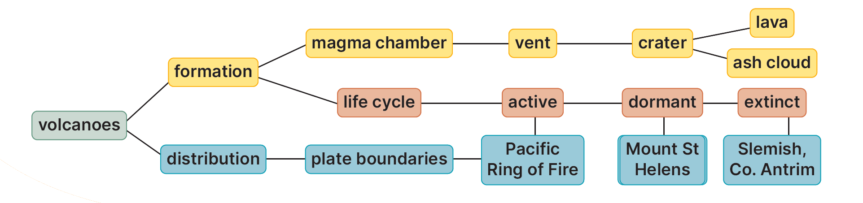
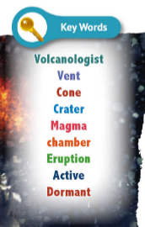
Keyword connections

Slide 4
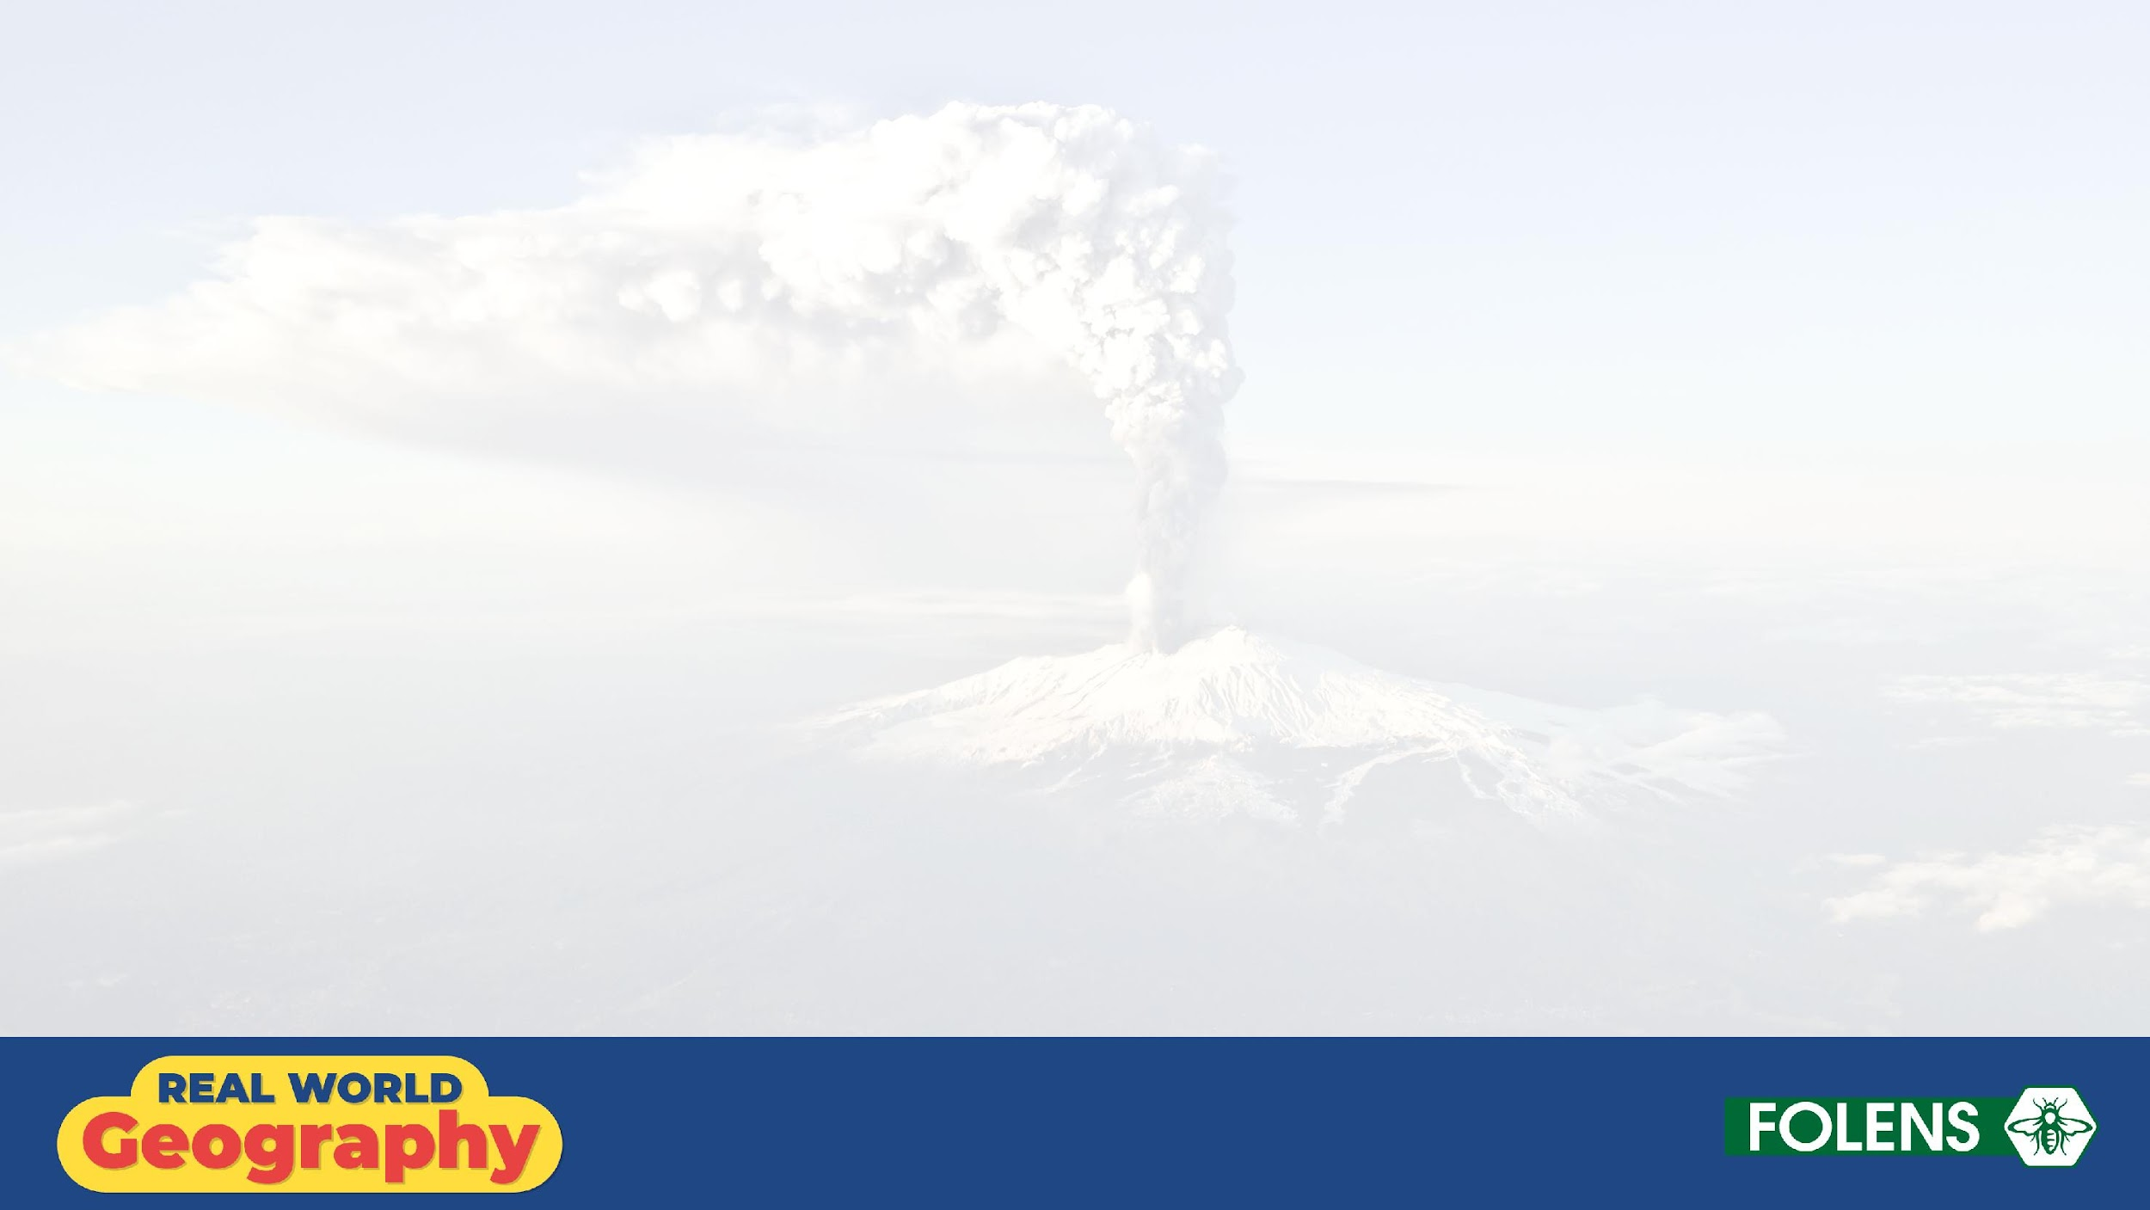
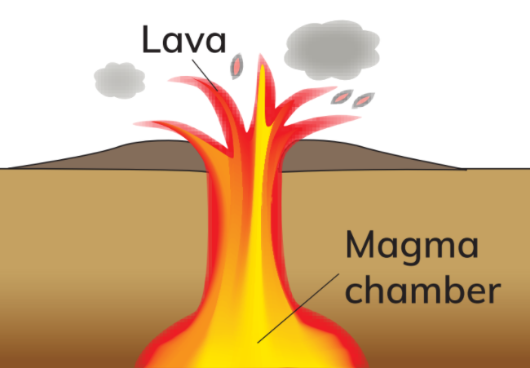
2.1 How Volcanoes are Formed
https://www.youtube.com/watch?v=K7Oq9_DU1Mc
A volcanic mountain,
or volcano, forms
when magma moves
up to the surface of
the Earth through a
small opening called
a vent.

Slide 5
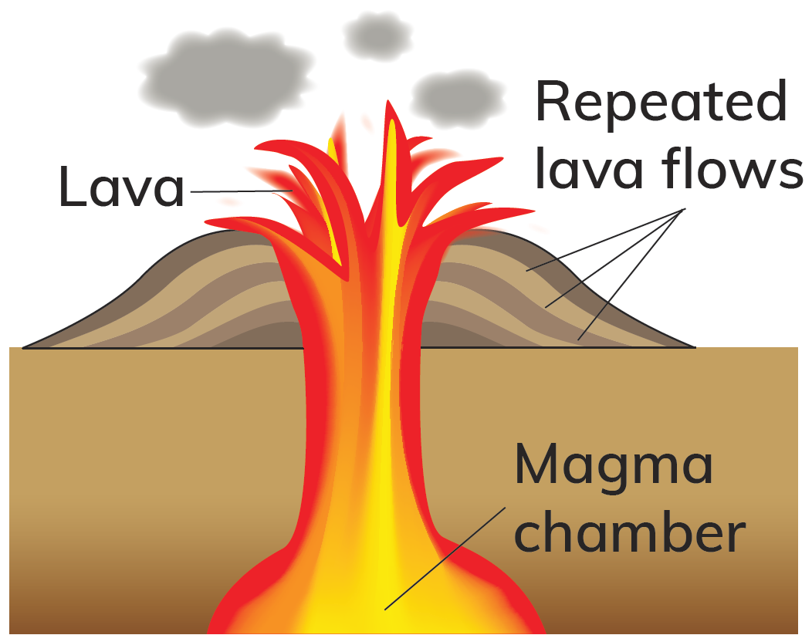
2.1 How Volcanoes are Formed
The magma is stored underground in
a magma chamber. The gases build up
in the magma chamber. The pressure
from the gases causes the magma
to erupt out of the vent through an
opening called a crater. When magma
reaches the Earth’s surface, it is known
as lava. The lava flow cools down and
hardens around the vent.

Slide 6
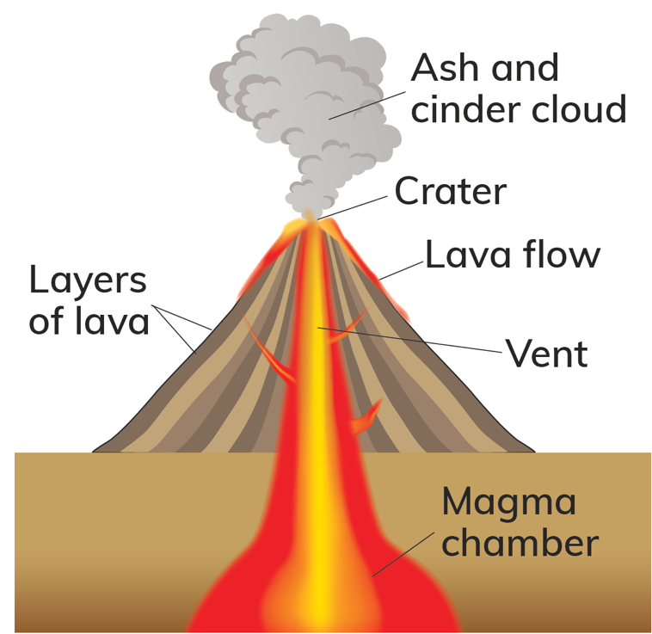
2.1 How Volcanoes are Formed
Other materials, such
as cinders and ash,
are also erupted
from a volcano. After
repeated eruptions,
layers of ash and
lava build up around
the vent to form
a cone-shaped
mountain.

Slide 7
HOW VOLCANOES ARE FORMED
1. A volcano forms when magma moves up to the surface through a small opening called a vent.
2. The magma is stored underground in a chamber called a magma chamber. Gases build up in the magma chamber and the pressure from the gases causes the magma to erupt out of the vent through an opening called a crater.
3. When magma reaches the Earth’s surface, it is known as lava.
4.The lava flow cools down and hardens around the vent. Ash and cinders are also ejected from a volcano when it erupts.
5. After repeated eruptions, layers of ash and lava build up around the vent to form a cone-shaped mountain.
6. An example of an active volcano is ___________ in __________. (Choose one from list below to finish your notes).
Mauna Loa - Hawaii.
Eyjafjallajokull - Iceland
Mount Vesuvius - Italy.
Mount Nyiragongo - Congo.
Taal Volcano - Philippines
Mount Merapi - Indonesia

Slide 8
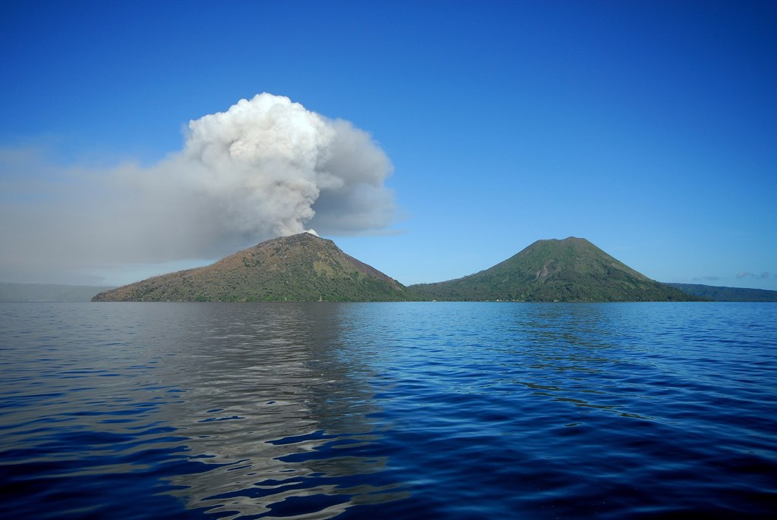
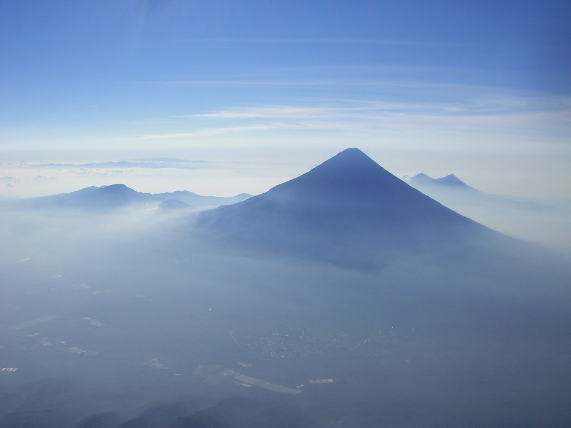
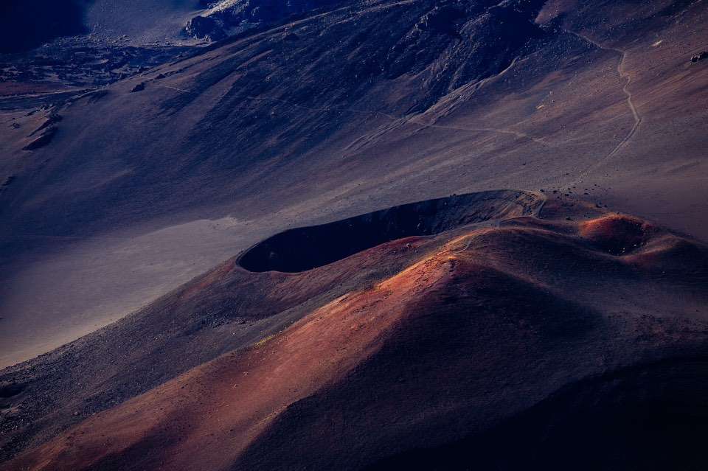
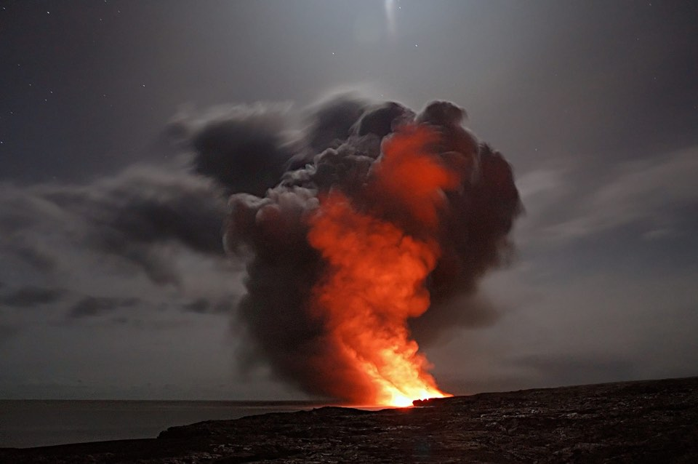
2.2
Volcanic Mountains
A crater at the top of a volcano
Two volcanic mountains
An eruption
Cone-shaped volcanic mountain
Notes:
Volcanic Mountains
Lava can force its way violently through a small hole known as a vent.
When this happens, a volcanic mountain is formed.
It is a cone-shaped mountain is formed with a crater at the top from which the lava flows.

Slide 9
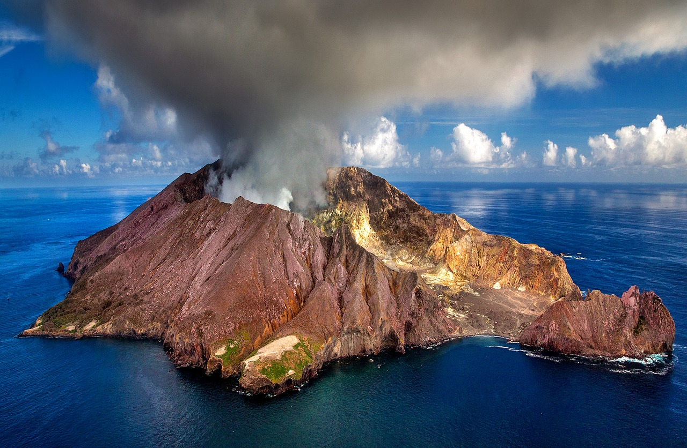
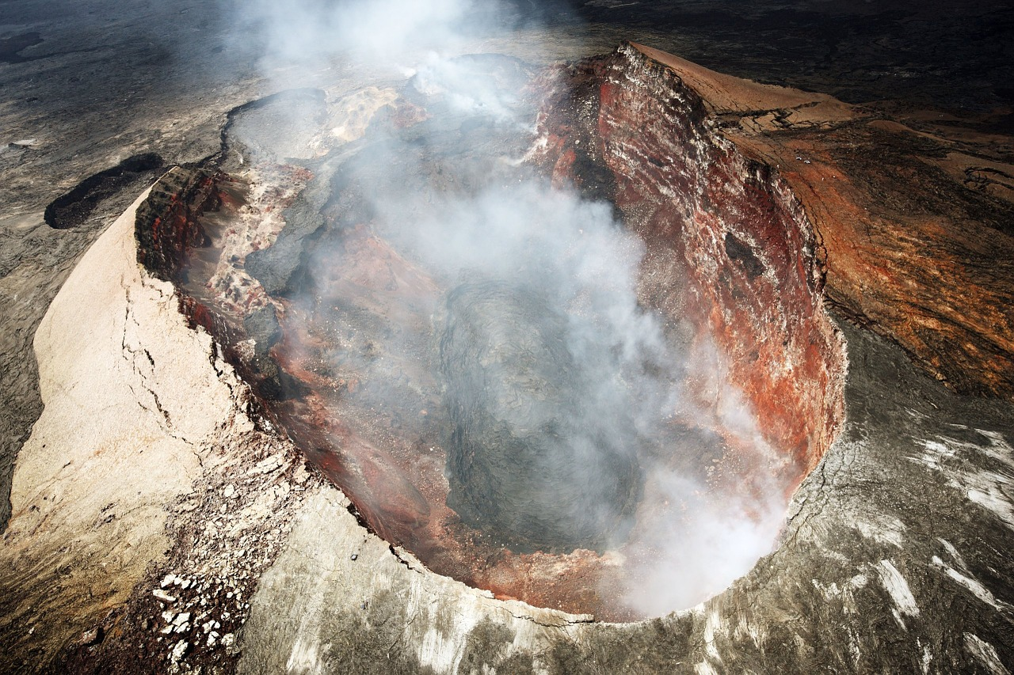
2.2
Volcanic Mountains
Erupting volcano
An eruption
Two volcanic mountains
A crater at the top of a volcano
Cone-shaped volcanic mountain
Notes:
Volcanic Mountains
Lava can force its way violently through a small hole known as a vent.
When this happens, a volcanic mountain is formed.
It is a cone-shaped mountain is formed with a crater at the top from which the lava flows.

Slide 10
2.1 How Volcanoes are Formed
Go to Section 2.1 on page 5 of your Skills Book.

Slide 11
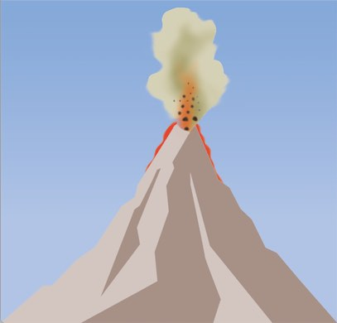
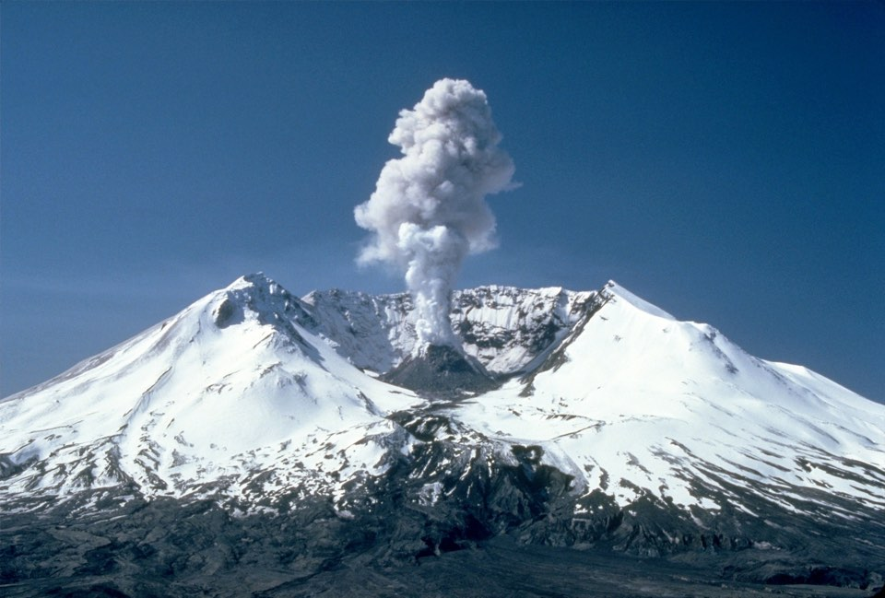
2.3
The Life Cycle of a Volcano
Active
Any volcano that has erupted in the past 10,000 years.
Mount St Helens
Notes:
The Life Cycle of a Volcano
Active
Any volcano that has erupted in the past 10,000 years.
Examples:
Cotopaxi in South America
Mount St Helens in North America

Slide 12
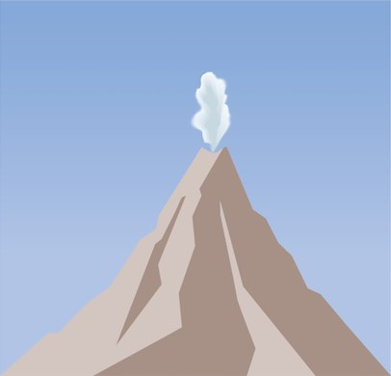
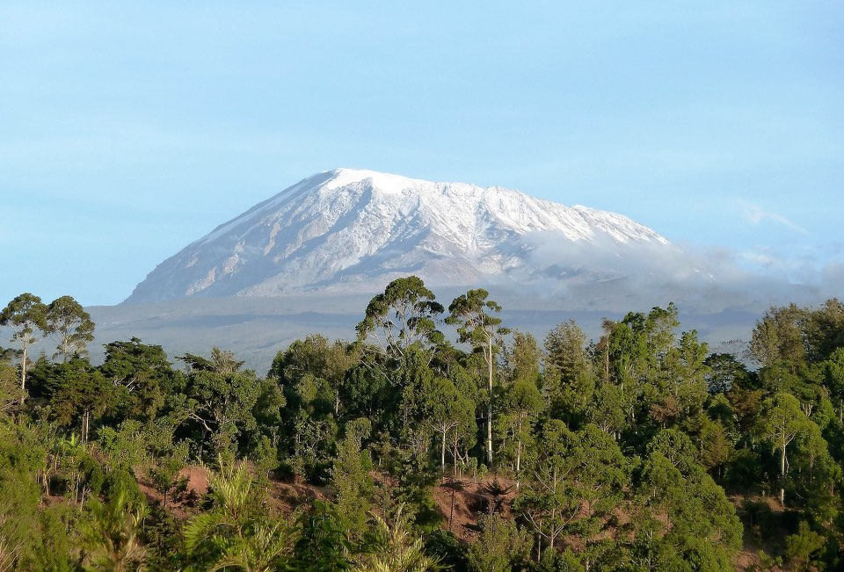
2.3
The Life Cycle of a Volcano
Dormant
A volcano that has not erupted in the past 10,000 years but is expected to erupt again in the future.
Kilimanjaro
Notes:
The Life Cycle of a Volcano
Dormant
A volcano that has not erupted in the past 10,000 years but that is expected to erupt again in the future.
Examples:
Kilimanjaro in Tanzania
Mount Tabor in North America

Slide 13

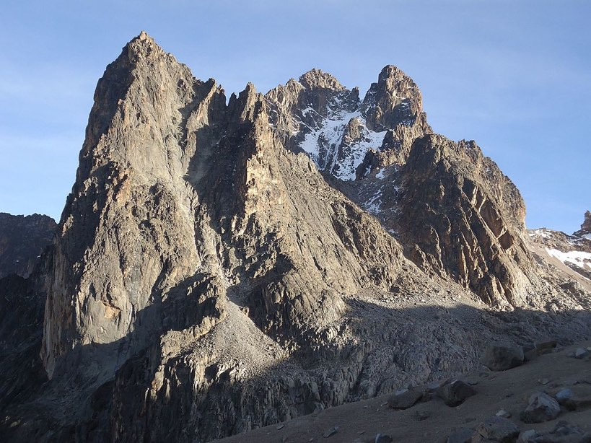
2.3
The Life Cycle of a Volcano
Extinct
A volcano that is never expected to erupt again.
Mount Kenya
Notes:
The Life Cycle of a Volcano
Extinct
A volcano that is never expected to erupt again.
Examples:
Mount Kenya in Kenya
Mount Warning in Australia

Slide 14
2.2 The Life Cycle of a Volcano
Stage of life cycle | Description | Example
Stage 1: Active | Erupts regularly - erupted in the past 10,000 years. | Mount Etna, Italy
Stage 2: Dormant | Has not erupted for some time but is expected to erupt again in the future | Mount St Helens, USA; erupted in 1985 after 120 years
Stage 3: Extinct | A volcano that is never expected to erupt again. | Slemish, Co. Antrim
The volcano has erupted periodically during the last 4,500 years, and the last active period was between 1831 and 1857.

Slide 15

2.1 and 2.2
1. What is a magma chamber?
2. What is the crater in a volcano?
3. What layers make up a volcanic mountain?
4. How did the Giant’s Causeway form?
5. What is meant by the term ‘active volcano’? Give an example.

Slide 16
2.1 and 2.2
Higher-order questions 1
1. Where does the magma in a magma chamber come from?
2. What do you think happens to a magma chamber if it never erupts?
3. Do volcanoes always have to have violent eruptions?

Slide 17
2.2 The Life Cycle of a Volcano
Go to Section 2.2 on page 6 of your Skills Book.

Slide 18
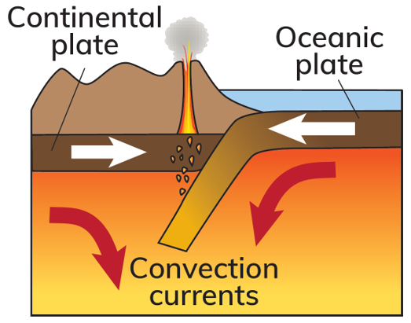
2.3 The Distribution of Volcanoes
Volcanoes can form at destructive plate boundaries, where two plates collide.
The heavier oceanic plate sinks below the lighter continental plate.
It melts in the mantle.
A blob of magma rises through the crust.
The magma can erupt and form a volcano.
Example: Mount St Helens, USA.

Slide 19
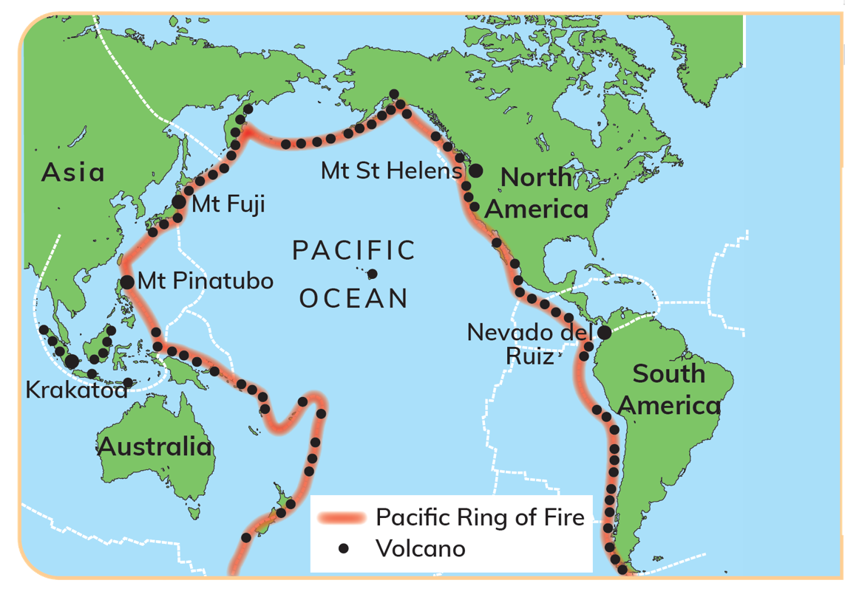
2.3 The Distribution of Volcanoes
The Pacific Ring of Fire

Slide 20
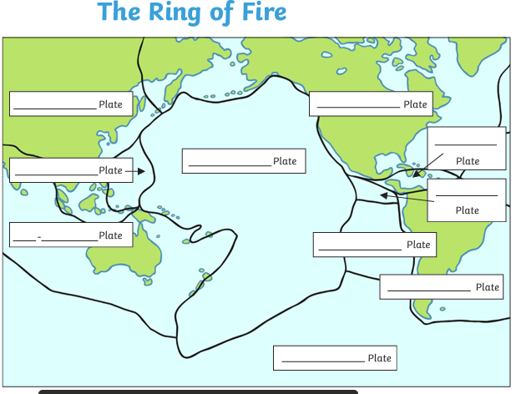

Slide 21
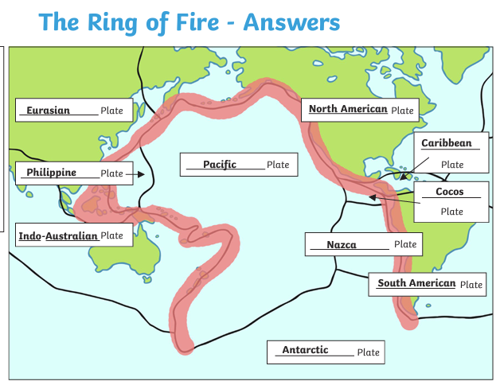

Slide 22
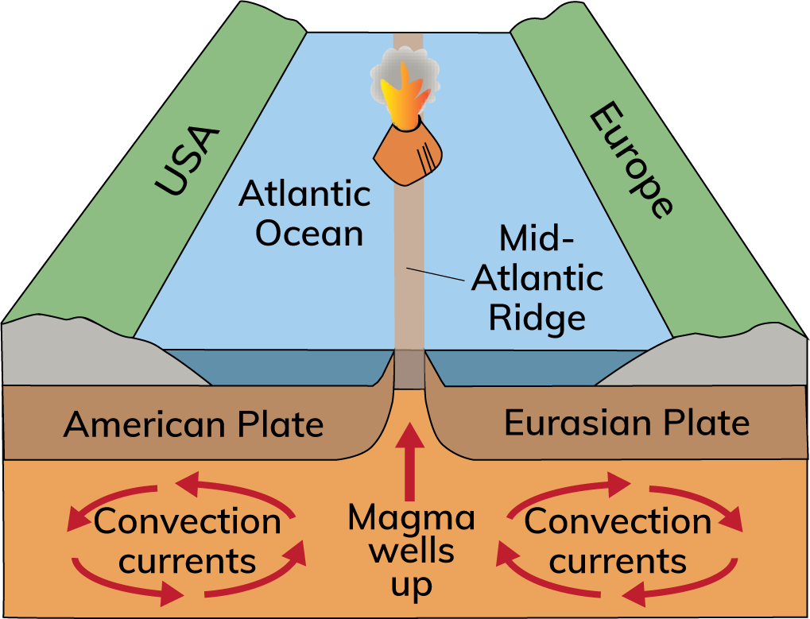
2.3 The Distribution of Volcanoes
Volcanoes can also form at constructive plate boundaries.
This happens when two plates separate.
Magma erupts and cools rapidly on the ocean floor.
Lava builds up.
A mid-ocean ridge forms.
Example: Mid-Atlantic Ridge.
If the mid-ocean ridge reaches the surface of the ocean, it forms a volcanic island.
Example: Iceland.

Slide 23

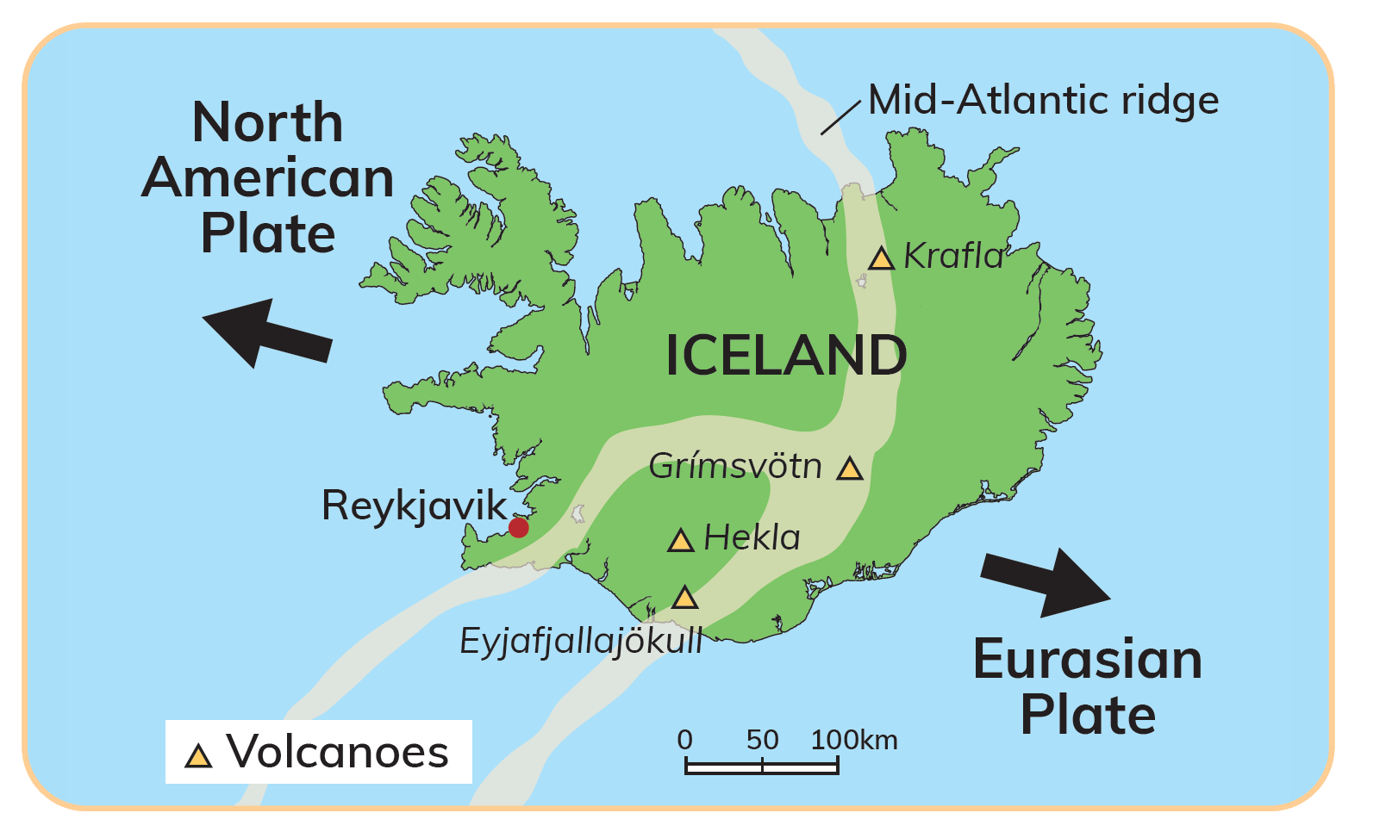
Iceland
https://www.youtube.com/watch?v=tUaN_tki82o
Iceland is a volcanic island.
It sits on top of the Mid-Atlantic Ridge.
It formed when a volcanic mountain built up on the seabed.
Iceland contains about 130 volcanoes.
Examples: Hekla and Krafla.
Iceland has many hot springs and geysers.

Slide 24
2.3 The Distribution of Volcanoes
Go to Section 2.3 on page 6 of your Skills Book.

Slide 25

2.3 The Distribution of Volcanoes
1. What does the word ‘distribution’ mean?
2. At what plate boundaries do volcanoes form?
3. Name one volcano that formed at a destructive plate boundary and one volcano that formed at a constructive plate boundary.
4. What is the Pacific Ring of Fire?
5. What is a volcanic island? Name one example.

Slide 26
2.3 The Distribution of Volcanoes
Higher-order questions 2
1. What comes out of a volcano when it erupts? List as many things as you can think of. Where do all these things go? (Hint: Do they all stay on the slopes of the volcano?)
2. Are there any constructive plate boundaries on land? Do they produce volcanoes?
3. What volcanic evidence is there that Ireland used to be on a plate boundary?

Slide 27
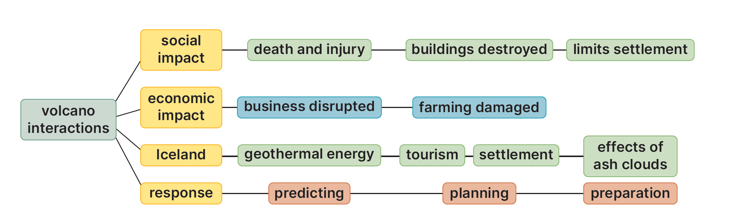
2.4 The Economic and Social Impact of Volcanoes on Iceland
Keyword connections

Slide 28
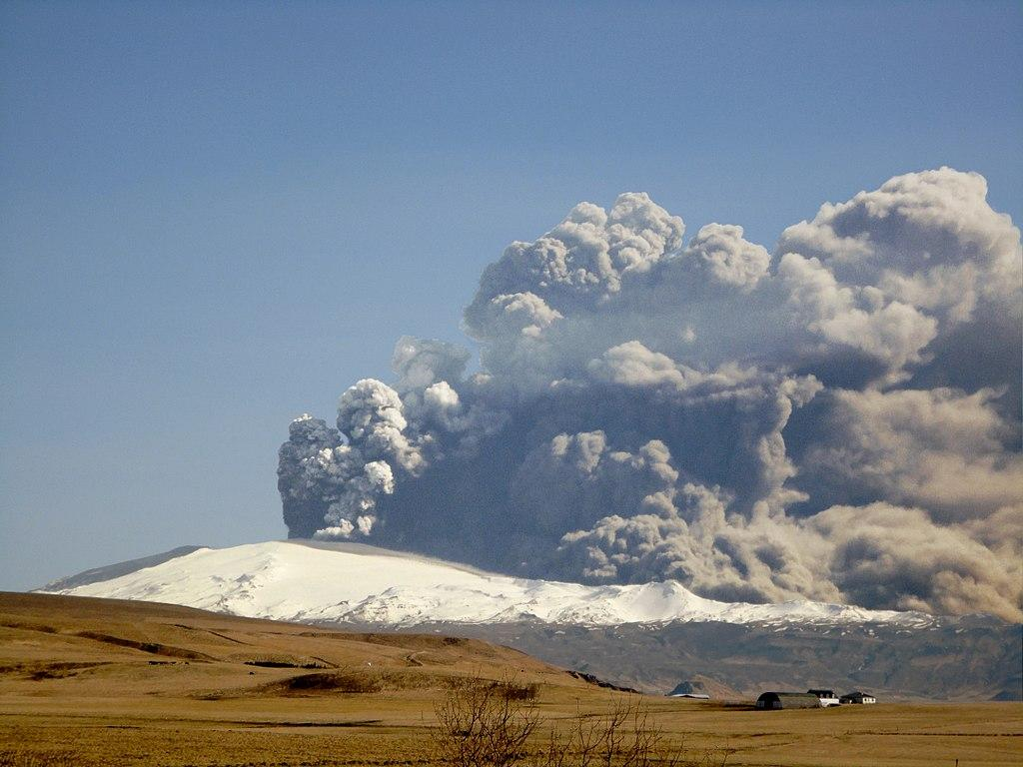
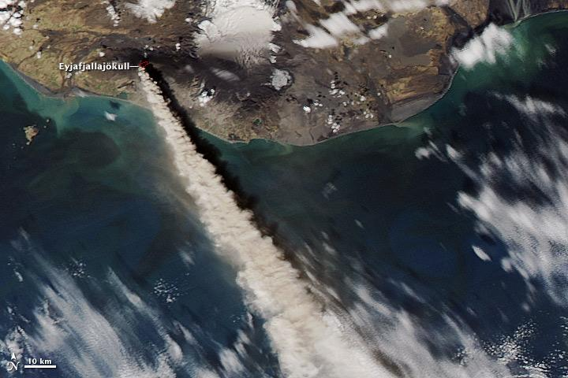
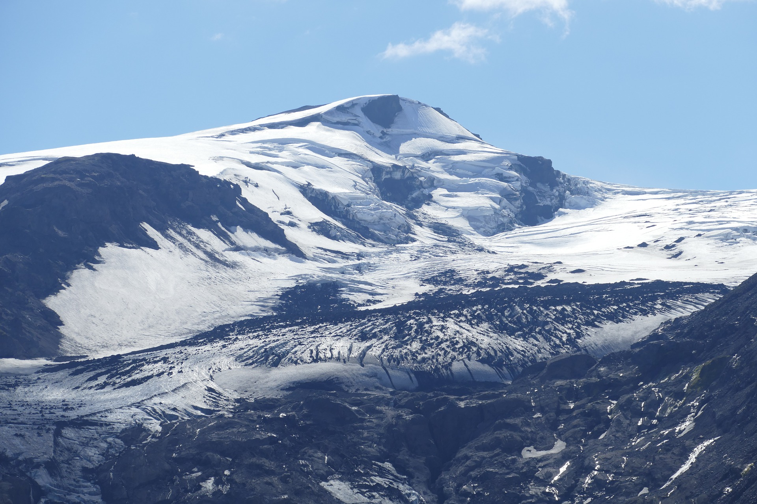
2.6
Economic and Social Impact
Eyjafjallajökull
Erupted in 14 April 2010
Ash sent several kilometres into the air
The ash cloud was blown across Europe
Notes:
Economic and Social Impact of Volcanoes: Case Study
Eyjafjallajökull
Erupted in 14 April 2010
Huge amount of ash sent several kilometres into the air
The ash cloud was blown across Europe

Slide 29
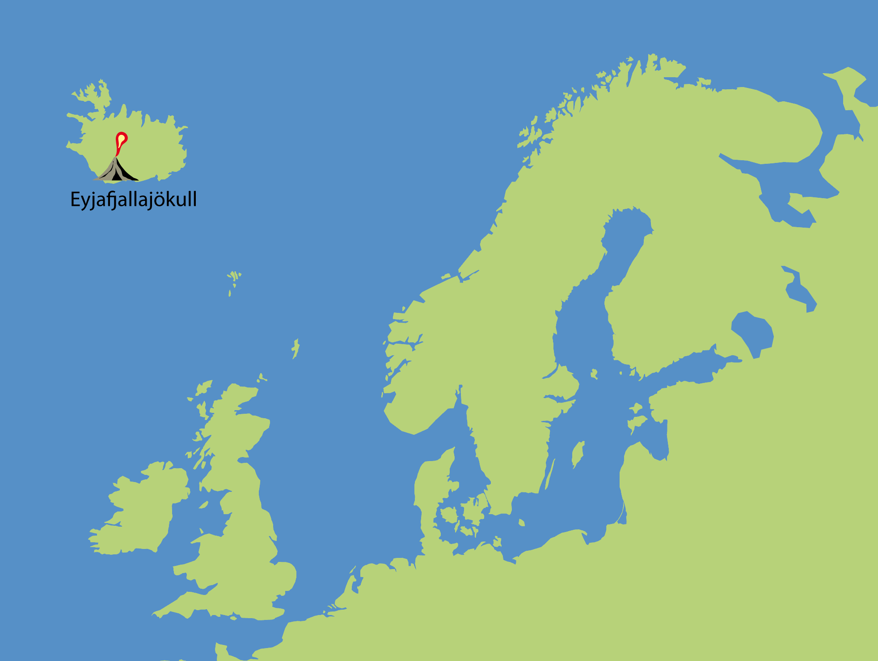

The span of the ash cloud caused by the eruption of Eyjafjallajökull
Notes:
Note to Teacher:
This PowerPoint presentation should be used in Slideshow View to display animated sequences.

Slide 30

2.6
POSITIVE Economic and Social Impact
Positive social impact
Positive economic impact
Increased tourism and unemployment
Generated income
Eyjafjallajökull increased tourism
New tourist attraction - Eyjafjallajökull visitor centre
Increased tourism created jobs
Generates income for local community
Fun Fact!
Fertile soil
In 2008, less than 500,000 people visited Iceland.
In 2016, 1.8 million visited Iceland.
Lava and ash are rich in nutrients
Soils in volcanic areas are very fertile and good for agricultural use
Notes:
Economic and Social Impact of Volcanoes: Case Study
Reduced unemployment
The development of tourism as a result of the volcanic eruption at Eyjafjallajökull created jobs.
Increased tourism and employment
After the eruption, a promotional campaign led to a big increase in the number of foreign tourists.
In 2008, Iceland was visited by fewer than 500,000 people. In 2016 the number of foreign travellers had increased to 1.8 million.
Generated income
A new Icelandic tourist attraction has been built – the Eyjafjallajökull visitor centre. This is generating income for the local community.
Fertile soil
Lava and ash are rich in nutrients, making the soils in volcanic areas very fertile and good for agricultural use.

Slide 31
2.6
NEGATIVE Economic and Social Impact
Negative social impact
Negative economic impact
Contaminated water supply
Travel chaos
Ash polluted the local water supply
100,000 flights cancelled over eight days
Farmers could not let their animals drink from streams near the volcano
20 countries closed airspace
Evacuation of locals
Loss of earnings
Five hundred families had to leave their homes
Fresh fruit could not be transported by plane
Locals and rescuers had to wear face masks to avoid choking on the ash
Over 1 million flower stalks went unsold in the first two days of the eruption
Notes:
Economic and Social Impact of Volcanoes: Case Study
Negative social impact
Contaminated water supply
Ash from the eruption polluted the local water.
Farmers near the volcano could not let their animals drink from the streams.
Evacuation of locals
Five hundred farmers and their families had to leave their homes.
Locals and rescuers had to wear face masks to avoid choking on the ash.
Negative economic impact
Travel chaos
Over eight days, 100,000 fights to and from Europe were cancelled because of poor visibility and the fear that tiny ash particles would clog up the engines of airplanes.
Twenty countries closed their airspace.
This cost airlines and businesses about €145 million per day
Loss of earnings
Countries, such as Kenya, that sell fresh fruit, vegetables and flowers to Europe were affected.
Fresh produce is transported by plane so they can arrive quickly.
The flight ban meant that this produce could not be sold.
Over 1 million flower stalks went unsold in the first two days of the eruption.

Slide 32
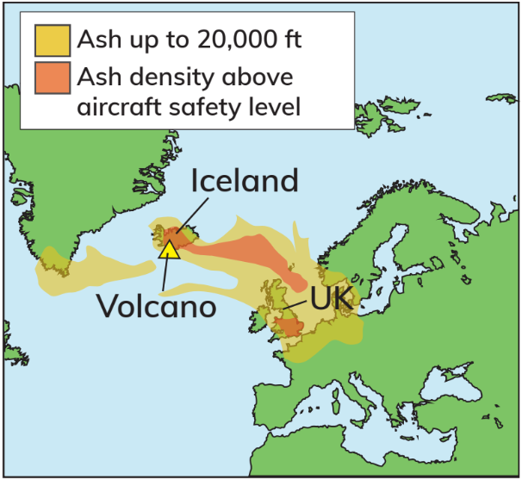
2.4 The Economic and Social Impact of Volcanoes on Iceland
Negative economic impacts
In March 2010, Eyjafjallajökull erupted:
A hot cloud of ash and volcanic glass was released into the atmosphere.
This caused severe disruption.
1. Travel
European air traffic control banned over 100,000 flights. 10 million people were affected. The ban on flying affected people travelling for business and tourism.
2. Transport
Fresh fruit, flowers, pharmaceuticals and electronic hardware could not be delivered. Companies in Africa and Asia were also affected. The overall cost of the ash cloud was approximately €3 billion.

Slide 33
2.4 The Economic and Social Impact of Volcanoes on Iceland
Positive economic impacts
1. Heating and electricity | 2. Agriculture and fish farming | 3. Tourism and recreation
Volcanoes produce geothermal energy. This is a renewable energy source. | Volcanic soil in Iceland is naturally warm. This helps grow potatoes and other vegetables. Geothermal energy is used to heat greenhouses. | Hot springs are a major tourist attraction. This earns valuable revenue. It provides jobs for local people in accommodation, transportation and retail.

Slide 34
2.4 The Economic and Social Impact of Volcanoes on Iceland
Negative social impacts
1. Settlement (1) | 2. Settlement (2)
The Mid-Atlantic Ridge runs through the middle of Iceland. As a result, large-scale settlement avoids the centre of the island. Most people live in or near the capital, Reykjavik, on the west coast. | The prevailing south-westerly wind carries the ash cloud from volcanoes towards the east. As a result, there are fewer settlements in the east of the country. To avoid this hazard from volcanic eruptions, seventy per cent of Iceland’s population lives in the south-west.

Slide 35
2.4 The Economic and Social Impact of Volcanoes on Iceland
Positive social impacts
1. Improved health | 2. Job creation
Iceland’s capital, Reykjavik, is one of the cleanest cities in the world. Using geothermal energy has improved air quality and people’s health. It reduces Iceland’s impact on climate change. | Tourism helps to reduce outward migration. Young people have found jobs in hotels, bars and restaurants. Job creation helps maintain a stable population in Iceland.

Slide 36

2.4 The Economic and Social Impact of Volcanoes on Iceland
1. What is geothermal energy?
2. Name three uses for geothermal energy in Iceland.
3. Describe briefly three positive impacts of volcanic activity in Iceland.
4. Describe three negative impacts of volcanic activity in Iceland.
5. Describe how geothermal energy has improved the wellbeing of people in Iceland.

Slide 37
2.4 The Economic and Social Impact of Volcanoes on Iceland
Higher-order questions 3
1. Is there geothermal energy in Ireland?
2. How does geothermal energy help limit climate change?
3. Why do some people continue to live near volcanoes?

Slide 38
2.4 The Economic and Social Impact of Volcanoes on Iceland
Go to Section 2.4 on page 7 of your Skills Book.

Slide 39
2.5 Responding to Volcanoes
Pair Plan
Pair up with a classmate.
In March 2010, Eyjafjallajökull erupted.
Imagine that a volcano is about to erupt near where you live.
You have been given the job of managing the effects of the eruption.
What is your plan to get people to safety?
How will you deal with the aftermath of the eruption?

Slide 40
2.5 Responding to Volcanoes
Short-term responses | Long-term responses
Use search and rescue teams to find survivors. Survivors will need medical treatment. Provide food, water and shelter. Set up information points for relatives. Control the disaster area. | Preparation Disaster response systems to allow aid to be sent quickly to locations affected by disasters Planning Hazard mapping to predict the likely path of lava flows Education Training people to be prepared for a disaster Rebuilding Rebuilding damaged property Restoring services

Slide 41
2.5 Responding to Volcanoes
Complete the CBA1 Warm-Up on page 18 of your Textbook.

Slide 42
2.5 Responding to Volcanoes
Go to Section 2.5 on page 7 of your Skills Book.

Slide 43
Assess your progress
Go to page 8 of your Skills Book and assess your progress.
2.1 Describe and explain how volcanoes are formed.
2.2 Name the different types of volcanoes.
2.3 Describe the distribution of volcanoes.
2.4 Describe and explain the economic and social impacts of volcanoes.
2.5 Describe and explain how people respond to and manage the effects of volcanoes.
Identify any gaps in your learning. Use the Rapid Revision on page 19 of your Textbook to jog your memory.

Slide 44


VOLCANO ERUPTS IN SOUTH ICELAND
A BBC News report on a volcanic eruption in southern Iceland.
Notes:
Note to Teacher: This video can be played in slideshow view. The YouTube link is below.
YouTube link: https://www.youtube.com/watch?v=8y2vNFhcaws

Slide 45

Video: Eyjafjallajökull Erupting
Notes:
Note to Teacher: You may need to log into your GillExplore account to view this video.

